Slide 1

Pitch Deck

Slide 2
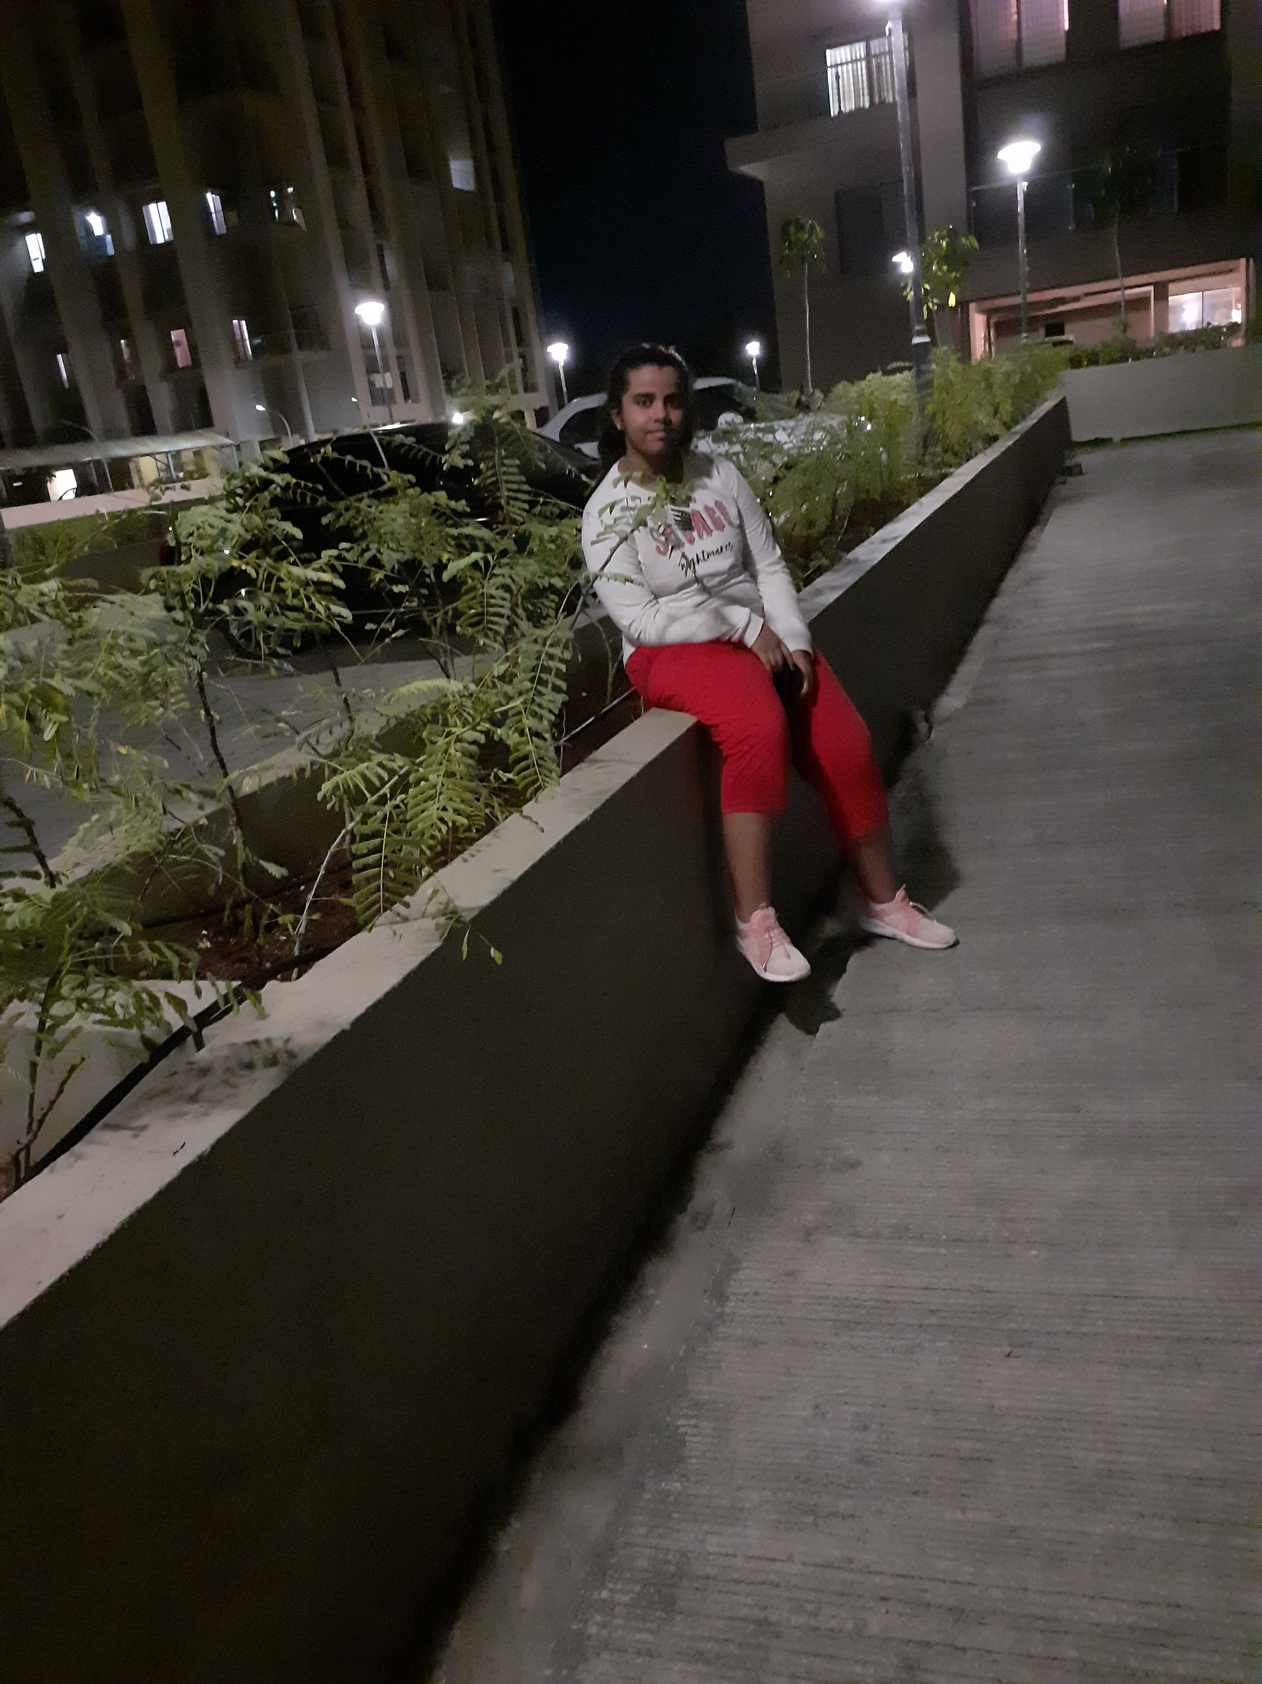
Introduction
I am Ankita Ganguly. I am building a website where students can get hands-on practice while learning their chosen topics.
I want to make sure that students will be well aware of the career paths they have chosen.
Apart from coding I like reading novels and listening to music.

Slide 3
01
Problem
02
Our Product
03
Inspiration
04
Change
Why I came up with the idea?
Students don’t get to do hands-on training along with studying
In this website, mentors will post projects of different topics and students will choose accordingly and do it.
Students having lack of knowledge regarding the on-site practices.
Lots of children can work without hesitation when on-site.

Slide 4
Problem
Students, especially teens start choosing their career line from a really young age.
But due to lack of information around the internet sometimes the teens end up not having much idea regarding their desired career choices.

Slide 5
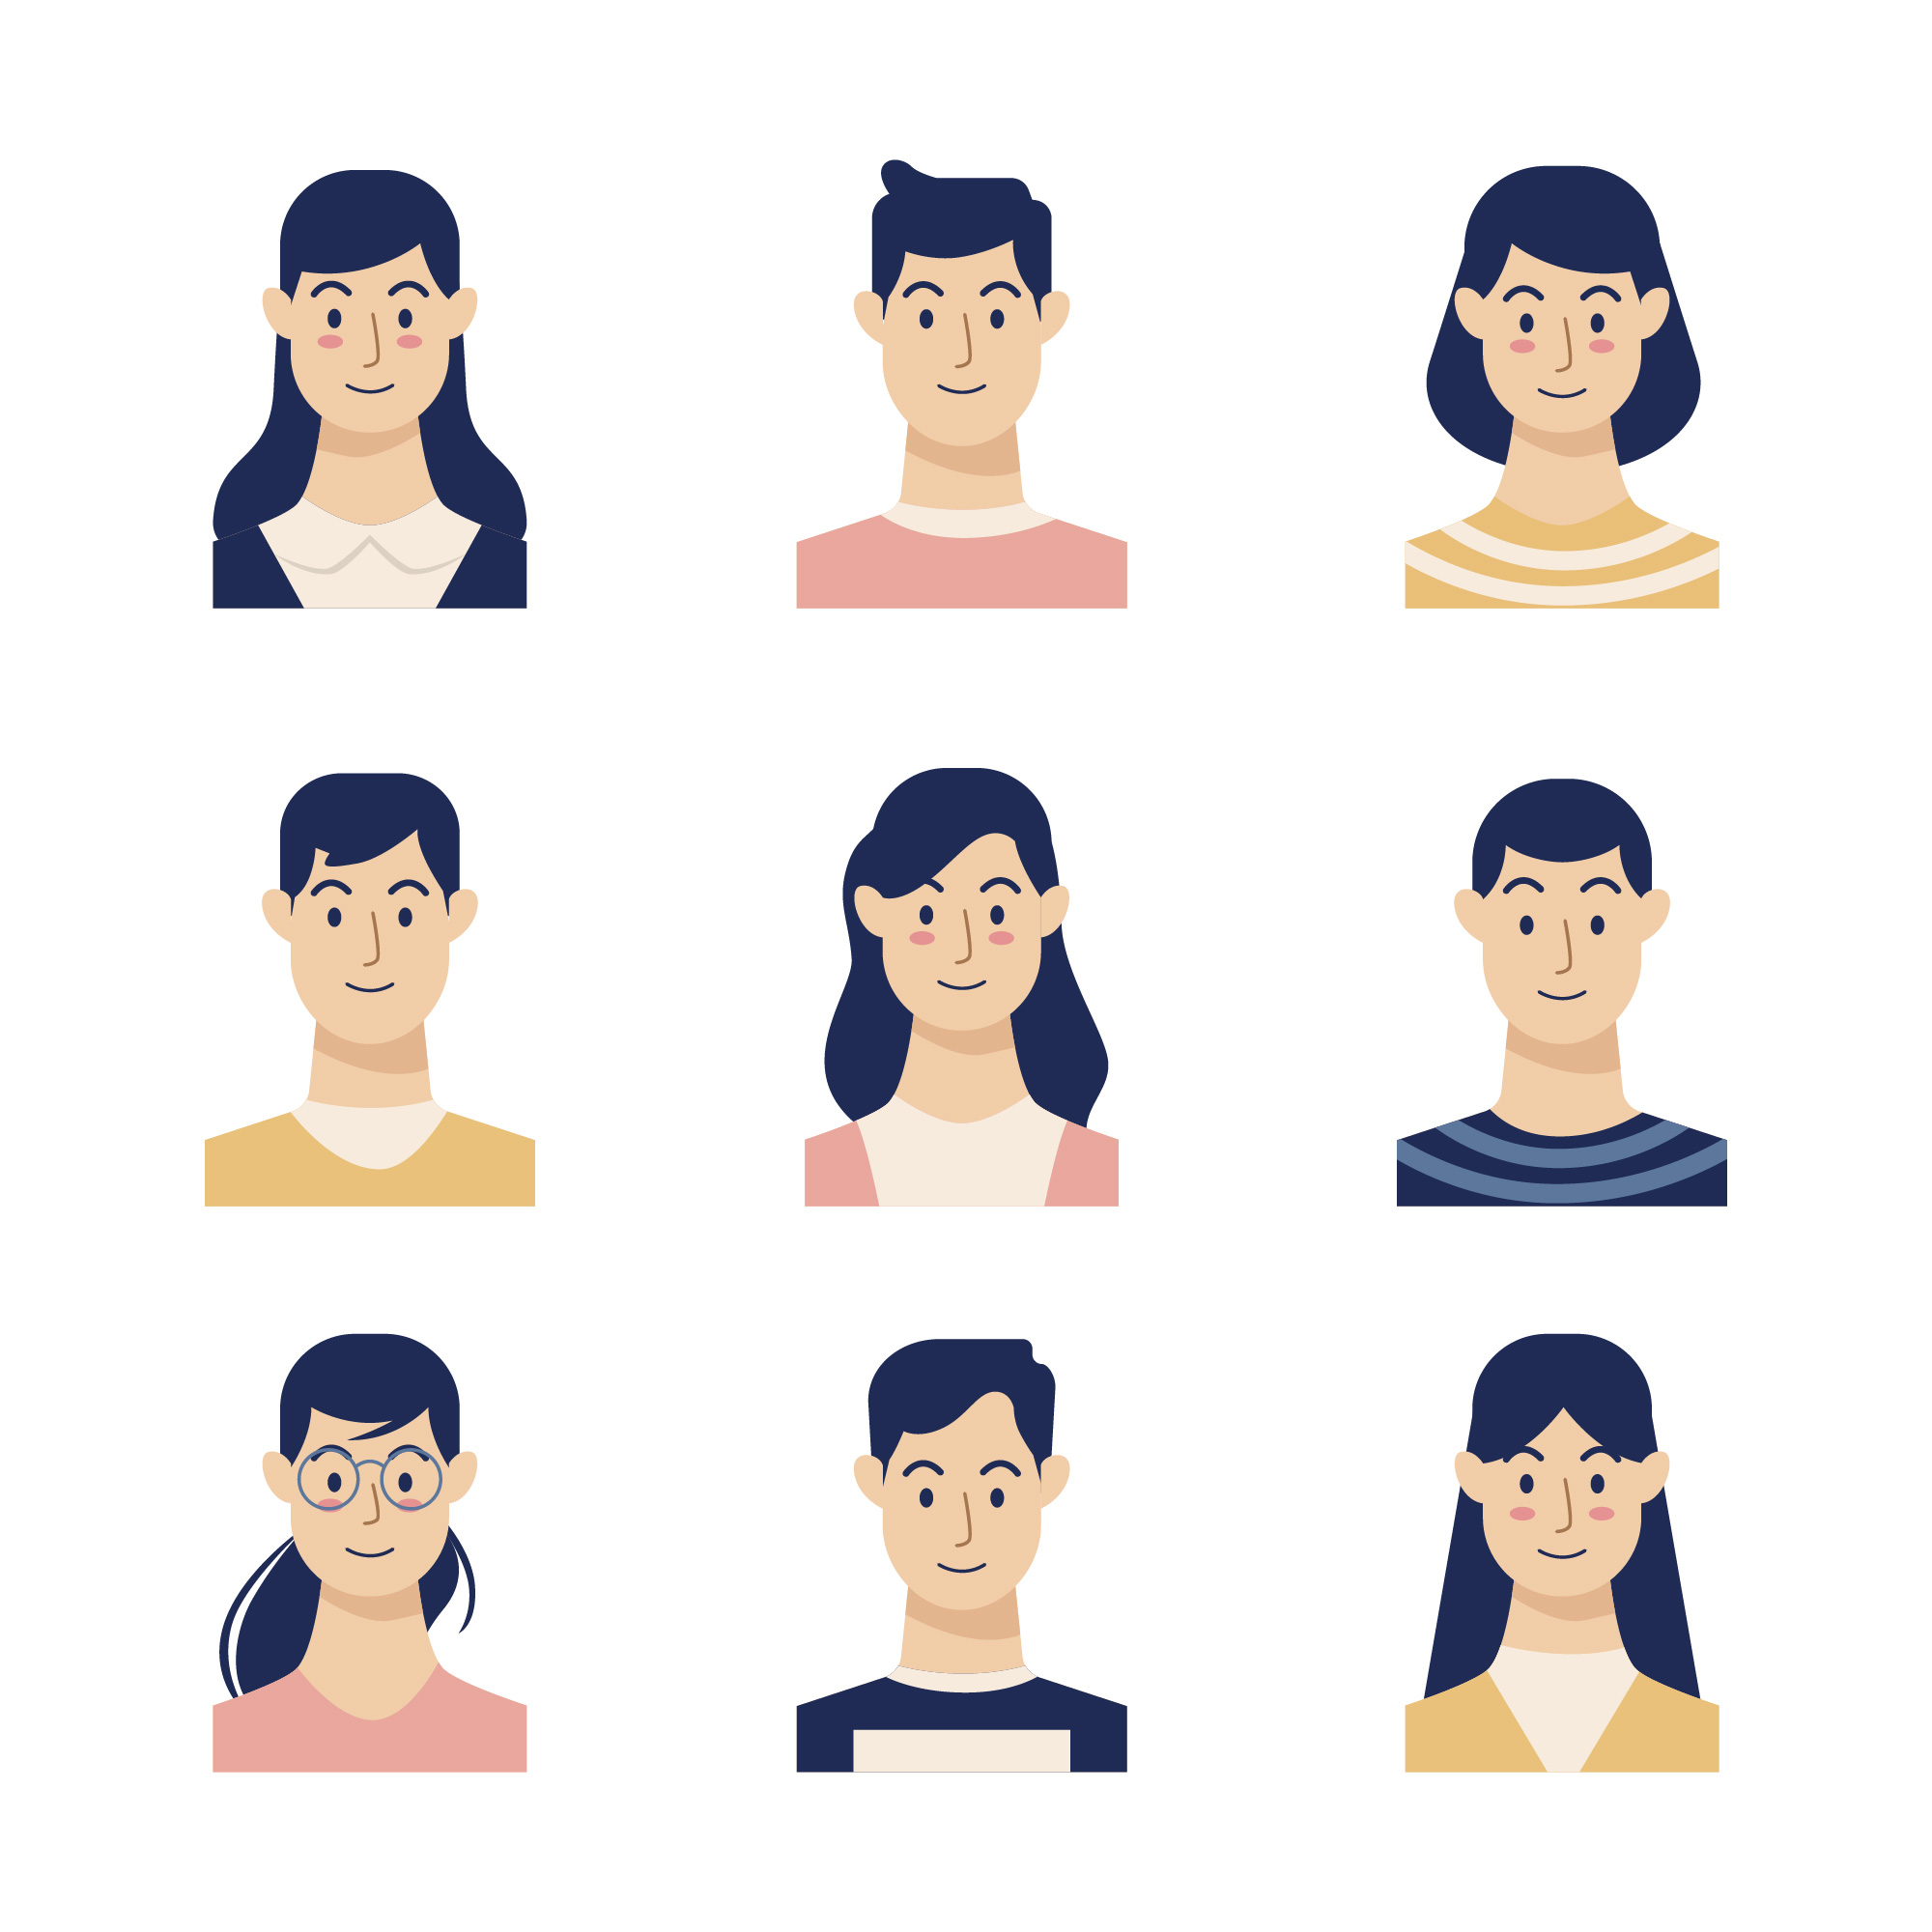
What people think of the problem
Pranjai Shah
Mannat Tyagi
It is quite a concerning problem as growing up, we also faced loads of problems being unaware of the on-site experience. The problems faced by the students will get limited, making it easy for them.
As a student, I feel hands-on training is equally important as studies. This gives us an idea about pros and cons regarding our chosen career paths.

Slide 6
Solution
Teens get an opportunity to select projects posted by experts in the area of their choice.
The mentors can post projects which can be selected by students in various fields.
The projects will be clearly instructed or described with the help of photos, videos, PDFs.

Slide 7
Similar Products On the Internet
WhiteHat Jr
Pirple.com
Skillshare
Khan Academy
WhiteHat Jr introduces and prepares your child from 6-18 years for this new coding world.
They've got courses on Frontend, Backend, Full-Stack, Mobile Dev, Data-Science, DevOps and Ethical Hacking.
Online learning community for people who want to learn from educational videos. Their primary goal of learning is by completing a project.
They produce short lessons in the form of videos. Its website also includes supplementary practice exercises and materials for educators.

Slide 8
Product Demo
Sign Up
Submit
Create your Zyper account and access your dashboard.
Submit the project and start working on another.
Watch
Select Project
Watch a video and get a little idea about the website.
Select a project and start working on it.

Slide 9
Product Demo

Slide 10
Product Demo

Slide 11
What new features need to be developed and why those features are important?
Chat
Review
Videos
A chat area should be introduced for allowing the students to talk with their mentors easily.
The projects should get reviewed and assessed by the mentors so the students will be aware of their performance.
A way of making and adding videos for mentors should be made so it is easy for students to understand.

Slide 12
Why do you believe this application is going to change lives around the world?
Thinking
Problem Solving
Entrepreneurship
Idea Thinkers
Organised
Increased Curiosity
Students will be able to think confidently.
Their way of problem solving will be easy.
Children will think about developing new things.
They will easily think of different solutions for a problem.
Students will stay organised regarding their career choices.
Their level of curiosity for developing will drastically increase.

Slide 13
Thanks!!!
Thankyou for your time meet you at Zyper.

